Slide 1
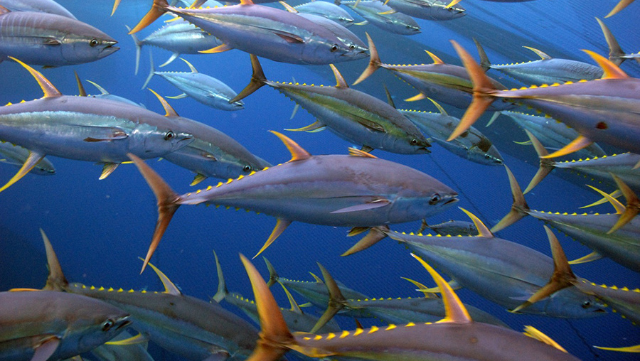
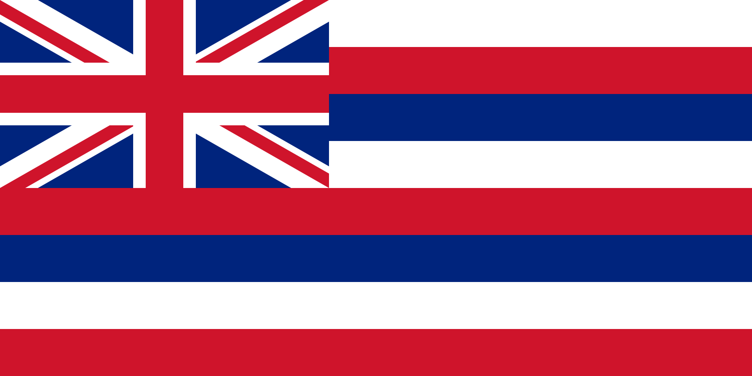
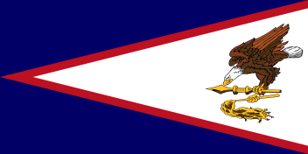
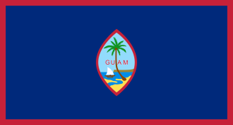
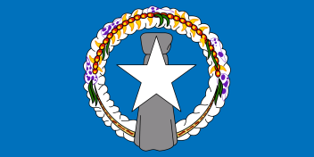
U.N. INTERGOVERNMENTAL CONFERENCE ON MARINE BIODIVERSITY OF AREAS BEYOND NATIONAL JURISDICTION (BBNJ)
Western Pacific Regional Fishery Management Council
1164 Bishop Street, Suite 1400
Honolulu, Hawaii

Slide 2
Background and Mandate
2015: UN General Assembly agreed to develop an international legally binding instrument under the UN Convention on the Law of the Sea (UNCLOS)
Convention on the Conservation and Sustainable Use of Marine Biodiversity of Areas Beyond National Jurisdiction (BBNJ)
Four Major Themes:
Marine Genetic Resources
Area-based Management Tools Including Marine Protected Areas
Environmental Impact Statements
Capacity-building and the Transfer of Marine Technology

Slide 3
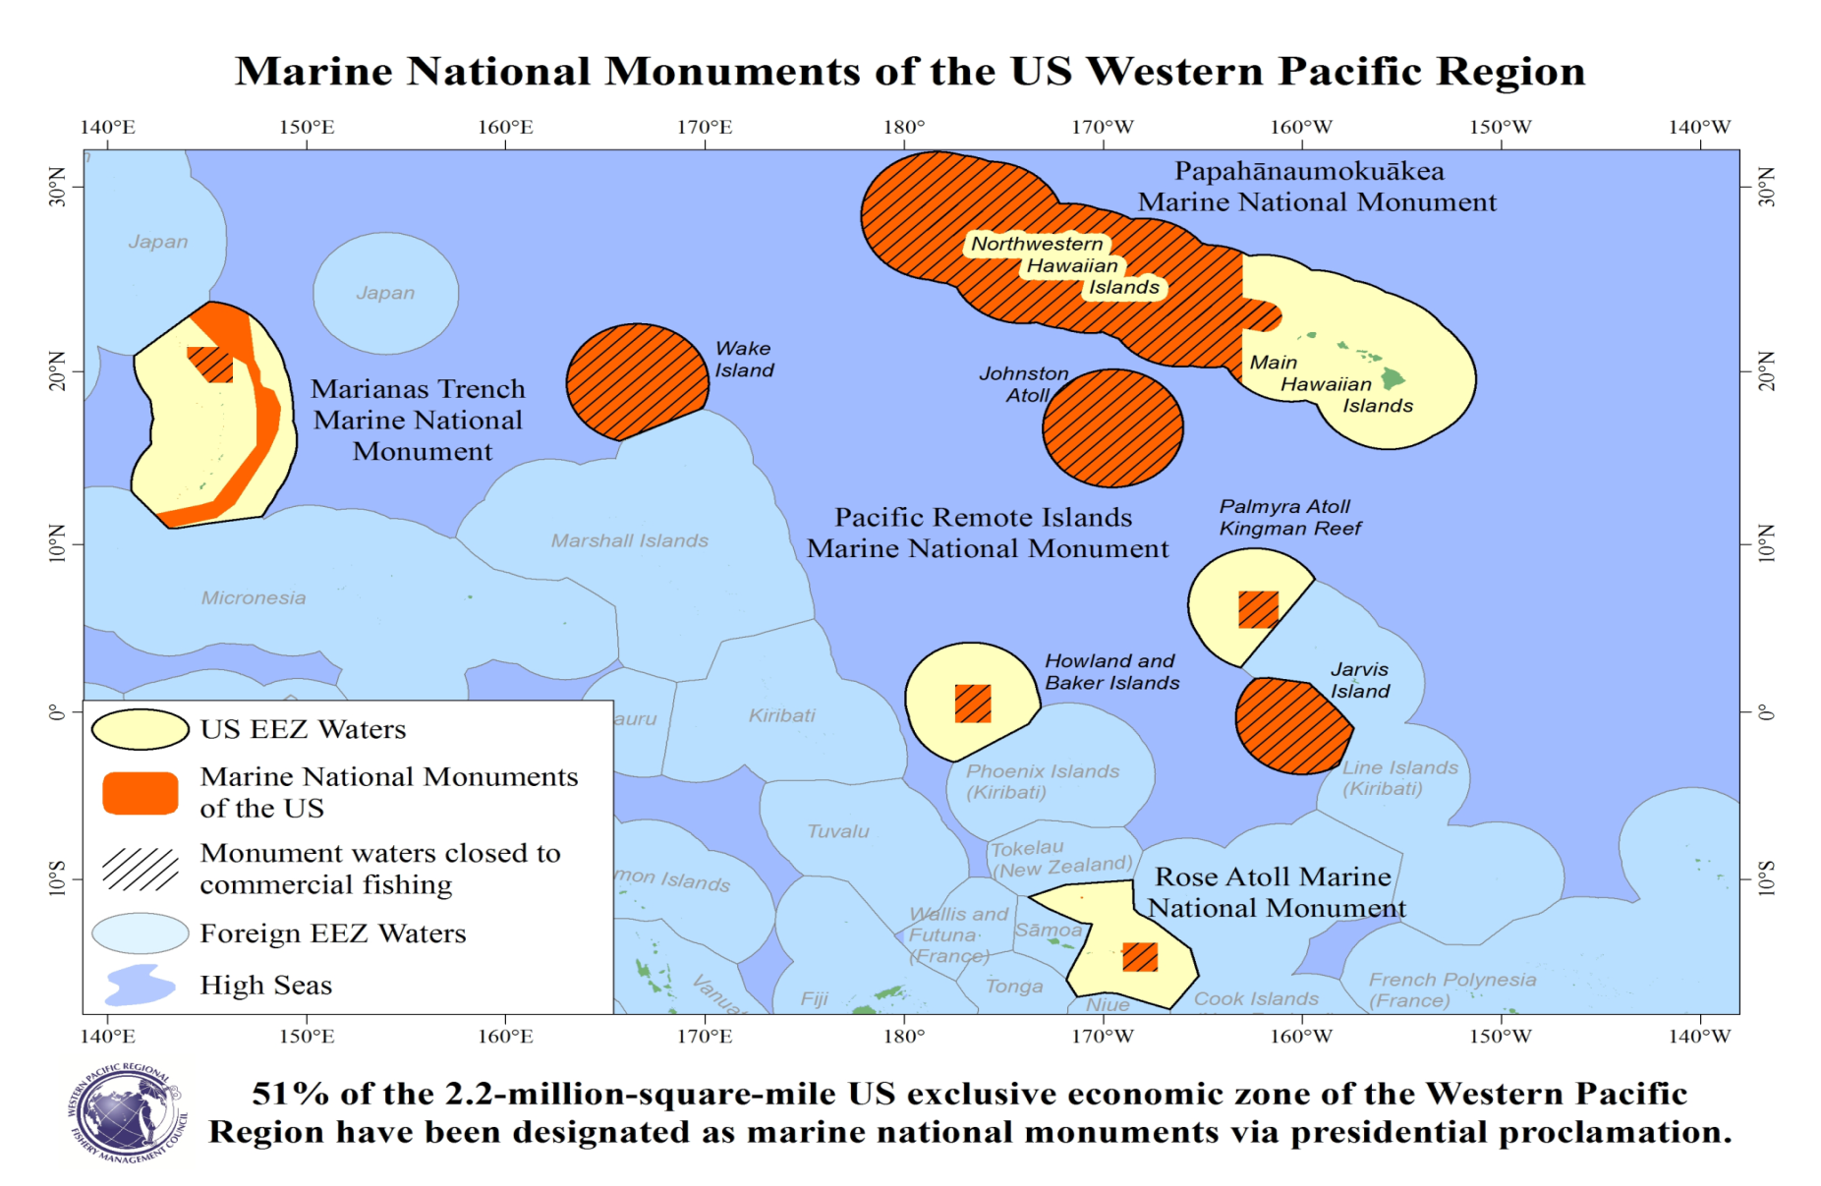

Slide 4
High Seas MPAs and BBNJ: Bottom Line for FMCs
Pacific Council: has not discussed or taken a position on BBNJ – focus has been on RFMO activities on managed fisheries. PFMC has HMS FEP which includes tunas (north Pacific albacore, yellowfin, bigeye, skipjack, and bluefin), sharks, billfish/swordfish.
Mid-Atlantic Council: has not discussed any positions on BBNJ, as most fisheries do not span further than 200 miles. MAFMC makes recommendations to NMFS HMS
South Atlantic Council: “Not on the radar” and no policy/positions at this time… few fishermen participating in Council-managed fisheries beyond EEZ (dolphinfish/wahoo, Sargassum). HMS fisheries managed by NMFS
North Pacific Council: has not made positions/comments on BBNJ, ecosystems interests already developed. International focus is on Arctic FMP

Slide 5
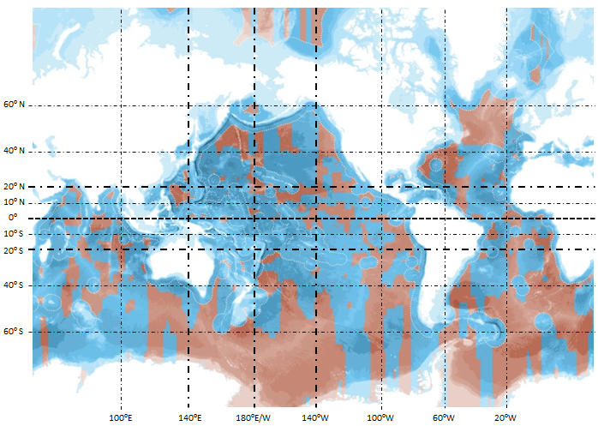
High Seas MPAs and BBNJ: Bottom Line for FMCs
“30 x 30” Initiative supported by Greenpeace and Oxford University academics promote and propose 30% high seas closures - outside most of the US EEZ

Slide 6
High Seas MPAs and BBNJ: Bottom Line for FMCs
Echoed by NGOs (i.e. “30% high seas closed to fishing” goal per Greenpeace 30x30 Initiative) which disproportionately impacts US HMS/oceanic fisheries based on their criteria
Impacts are most significant to WPRFMC but could have impacts on other FMCs with open ocean or HMS fisheries
WPRFMC has addressed BBNJ and developed guidelines for spatial management
US EEZ under WPRFMC purview already majority closed areas

Slide 8
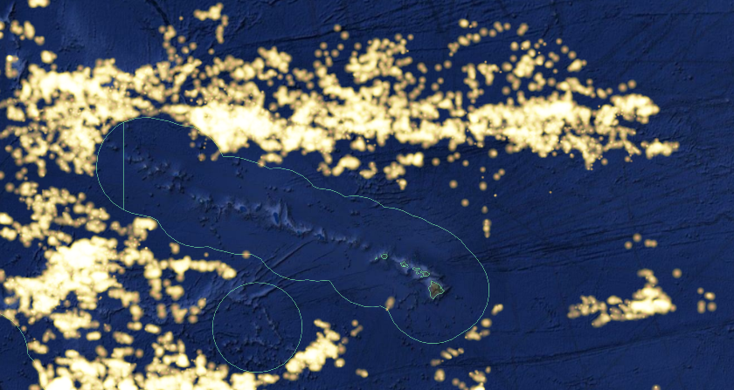
Hawaii
Johnston
Atoll
3 months fishing effort by foreign vessels November 9 2019 – February 9 2019
Flags: Japan, China, Korea, Chinese Taipei, and Vanuatu
Vessels: predominately longline vessels targeting tuna and swordfish
Source: Global Fishing Watch

Slide 9
JA
JA
Wake
CNMI
Guam
RMI
FSM
6 months fishing effort Jan 1- June 30 2018
All flags
Vessels: Most effort east of CNMI EEZ is Japanese pole and line vessels; other vessels include longline and purse seine
Source: Global Fishing Watch

Slide 10
Palmyra
Howland & Baker
Jarvis
Am Samoa
6 months fishing effort May 1- October 30 2018
All flags
Source: Global Fishing Watch

Slide 11
Take-home Messages on BBNJ
Negotiations on the UN Convention on BBNJ are happening now (discussed at COFI 33 and will be at COFI 34)
The result could substantially change the management framework for HMS fisheries and for fisheries operating on the high seas
Significant concern for Council-managed fisheries that depend on access to high seas fishing grounds
The CCC should make recommendations regarding BBNJ and develop proactive positions pertaining to similar conventions, should they be introduced in the future.
The CCC should recommend US State Department to consult with FMCs on a regular basis during the negotiation of the new BBNJ convention.
The CCC should request the State Department (and NMFS) to provide a briefing at the November , 2019 CCC meeting on the reason for this initiative, the US position, Convention timing, etc.

