Slide 1

2019 Council Coordination Committee Meeting
Regional Councils & NMFS Leadership Roster
May 14-16, 2019
Charleston, South Carolina

Slide 2
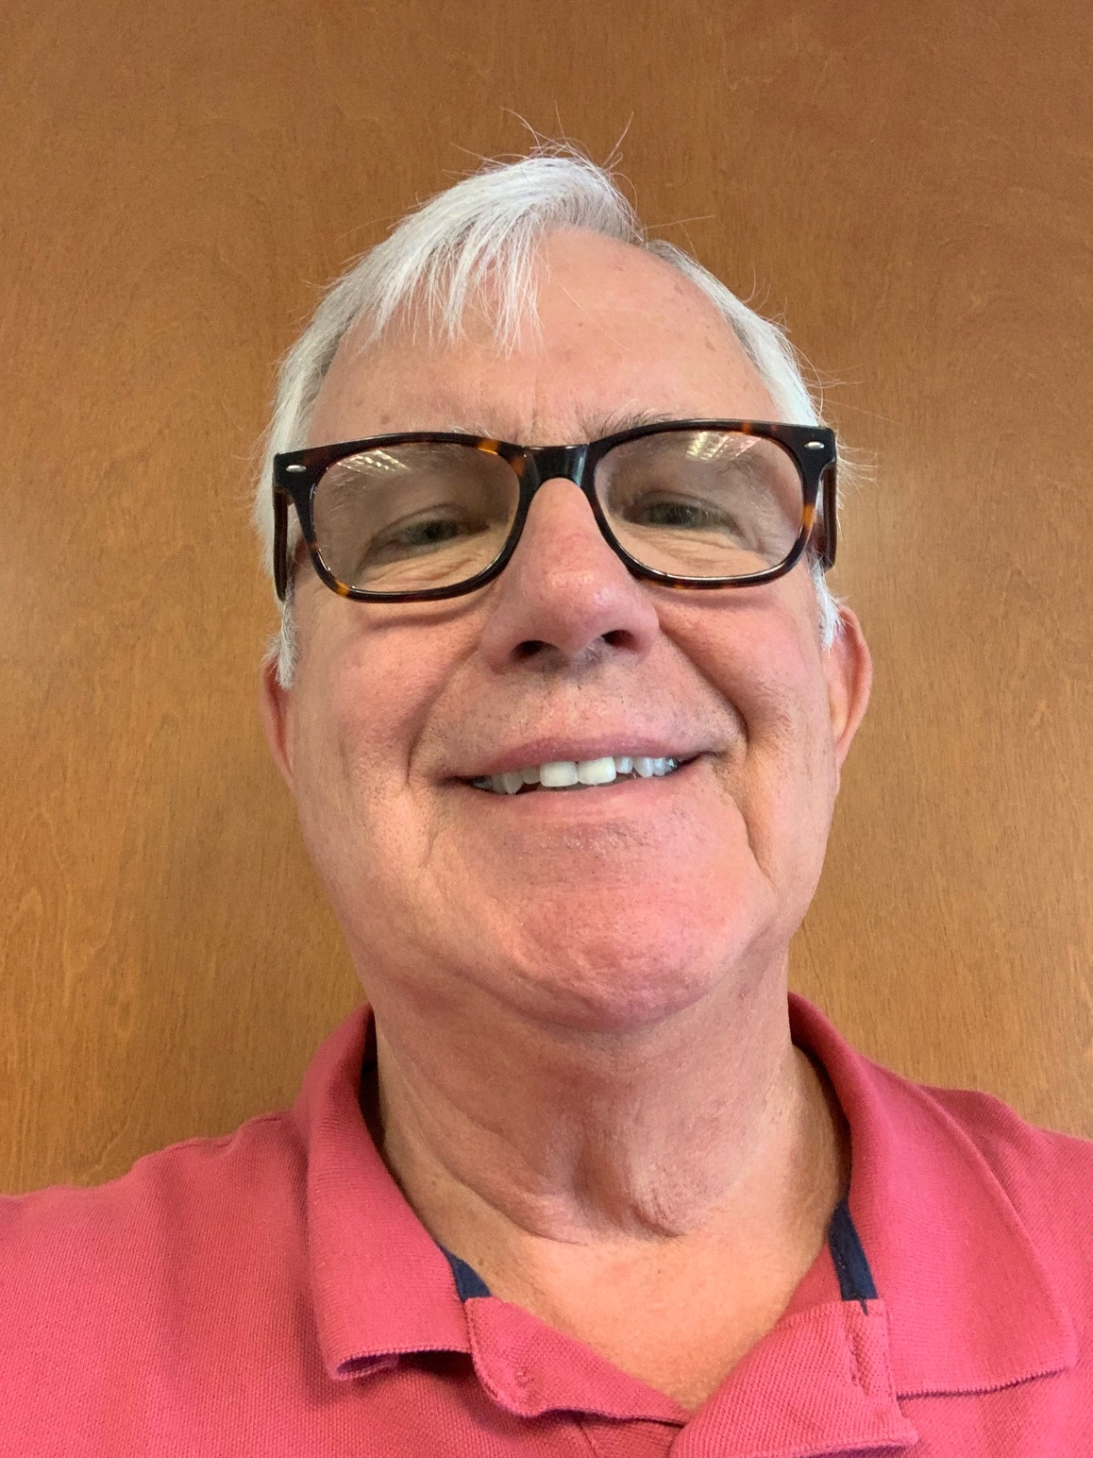
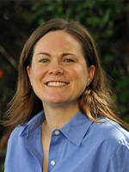
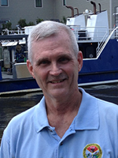
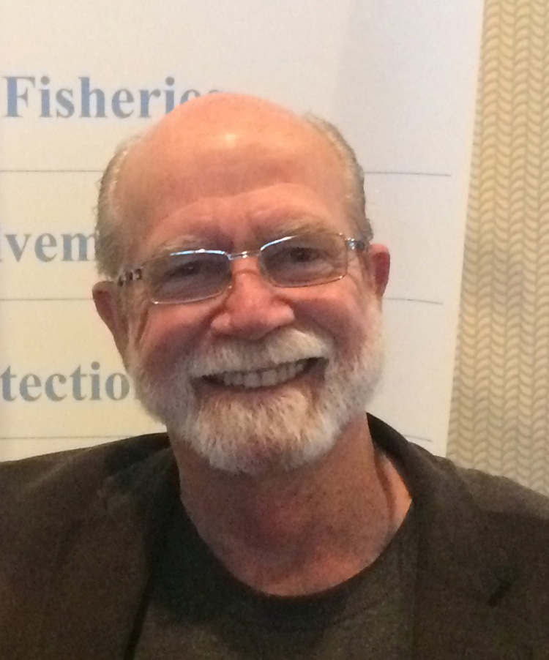
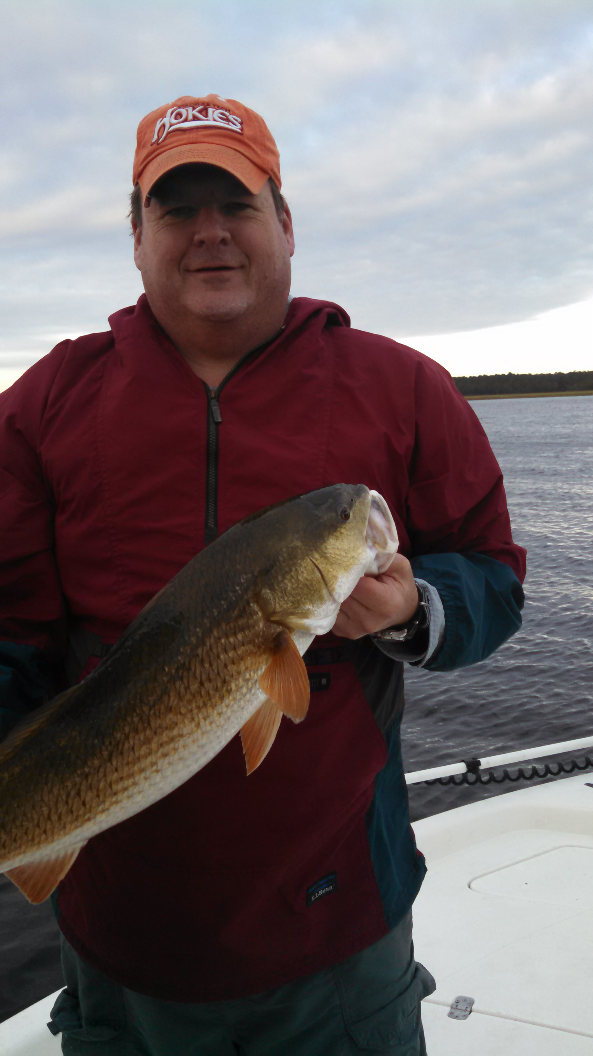
South Atlantic
Fishery Management Council
Dr. Brian Cheuvront
Deputy Director Management
John Carmichael
Deputy Director Science & Statistics
Jessica R. McCawley, Chair
Florida
Mel Bell, Vice Chair
South Carolina
Gregg T. Waugh
Executive Director

Slide 3

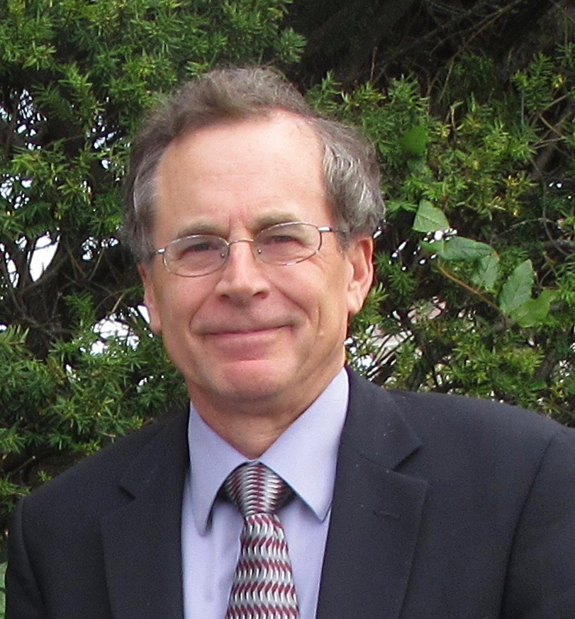
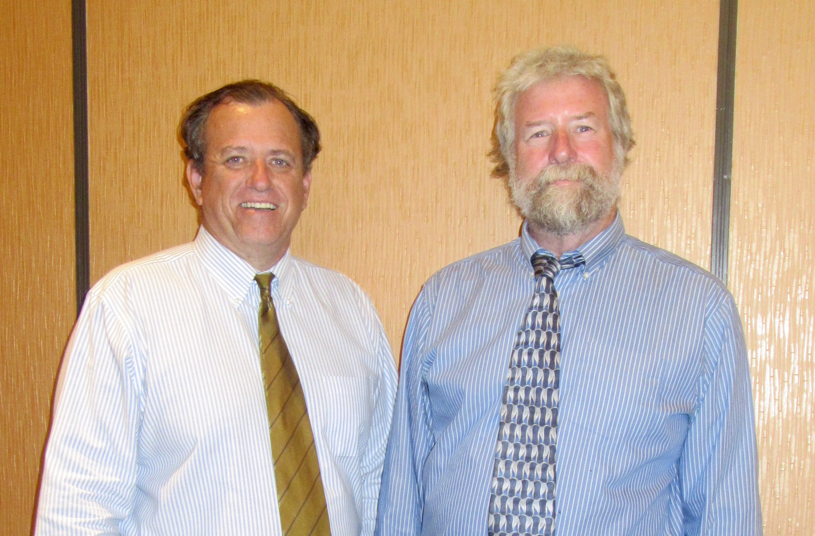
Tom Nies
Executive Director
Dr. John Quinn, Chair (left)
Massachusetts
Terry Stockwell, Vice Chair (right)
Maine

Slide 4

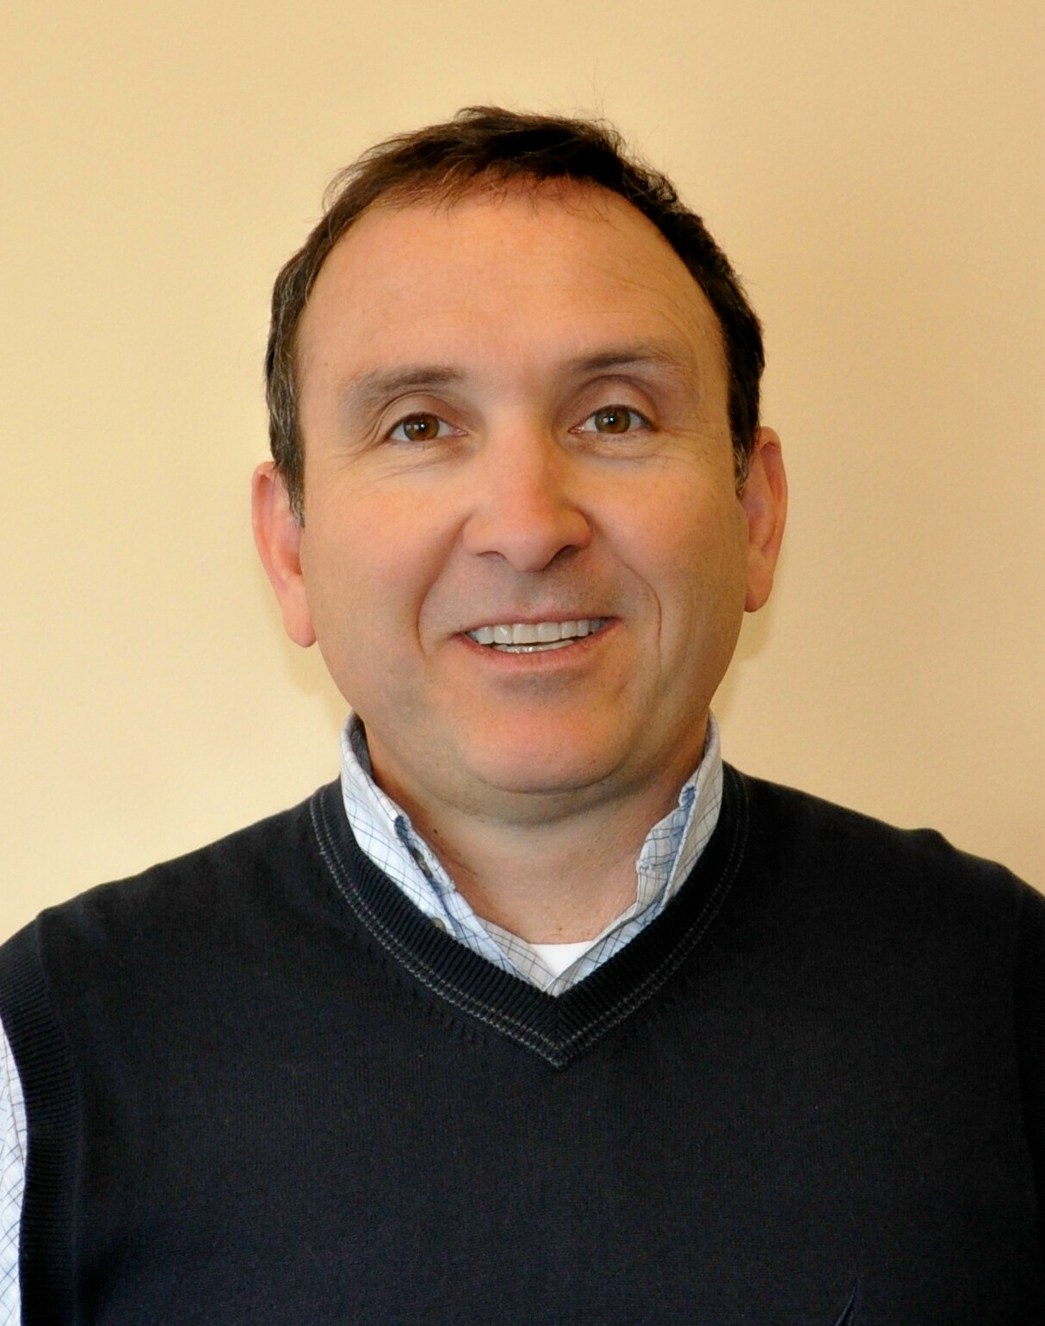
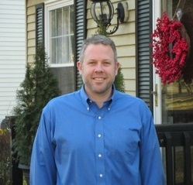
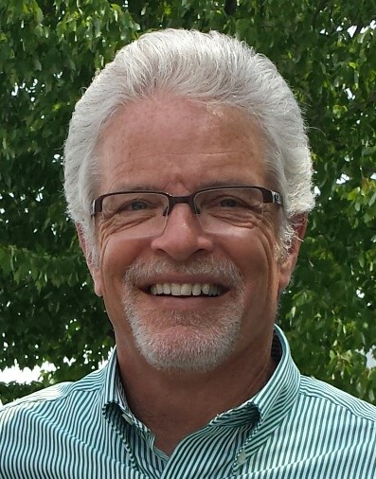
Dr. Chris Moore
Executive Director
Mike Luisi, Chair
Maryland
Warren Elliott, Vice Chair
Pennsylvania

Slide 5
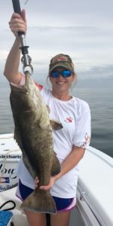
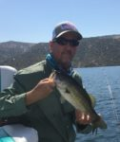
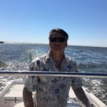
Gulf of Mexico
Fishery Management Council
Dr. Carrie Simmons
Executive Director
Dr. Thomas Frazer, Chair
Florida
Dale Diaz, Vice Chair
Mississippi

Slide 6

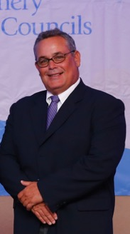
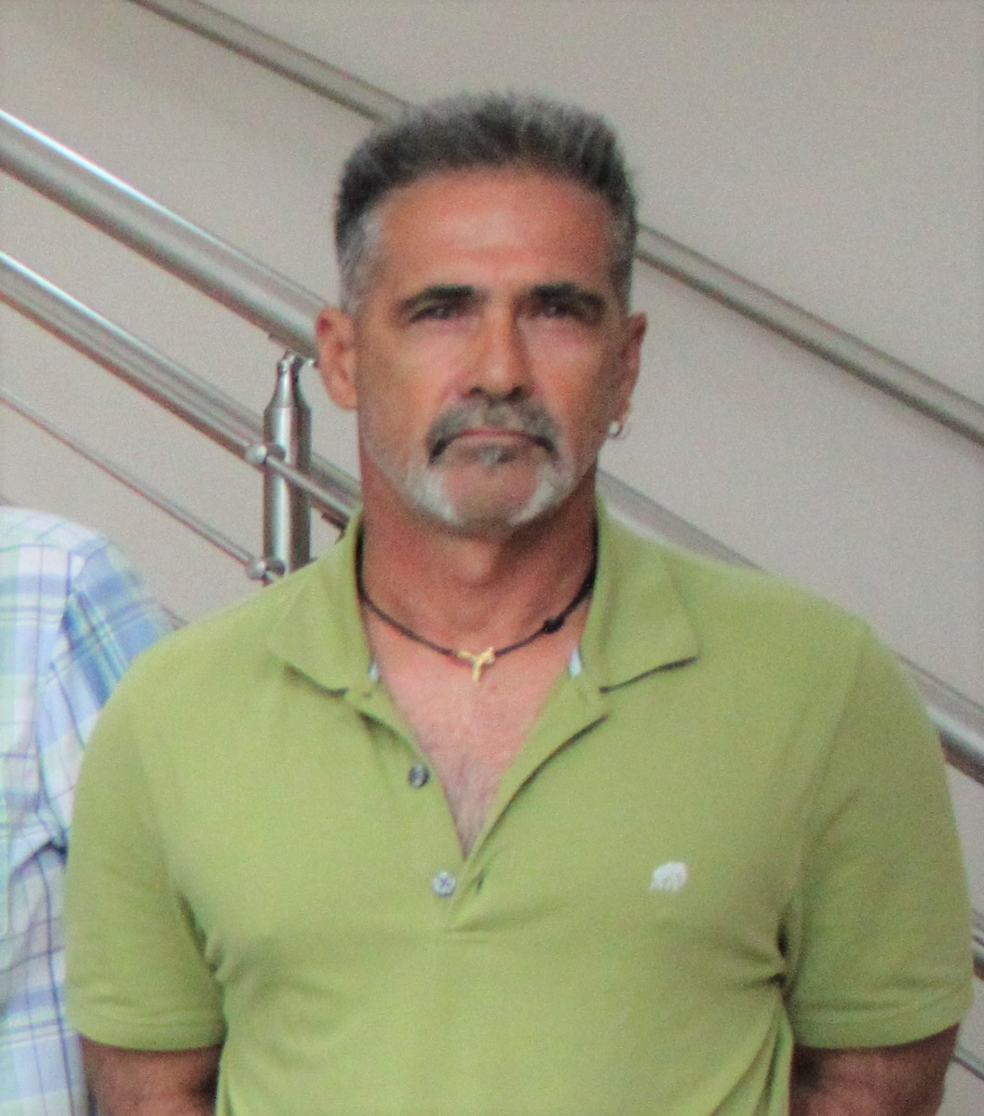
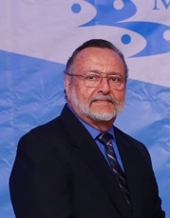
Caribbean
Fishery Management Council
Marcos Hanke, Chair
Puerto Rico
A. Louis Blanchard, Vice Chair
United States Virgin Islands
Miguel A. Rolón
Executive Director

Slide 7

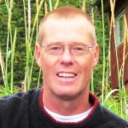
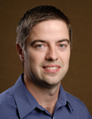
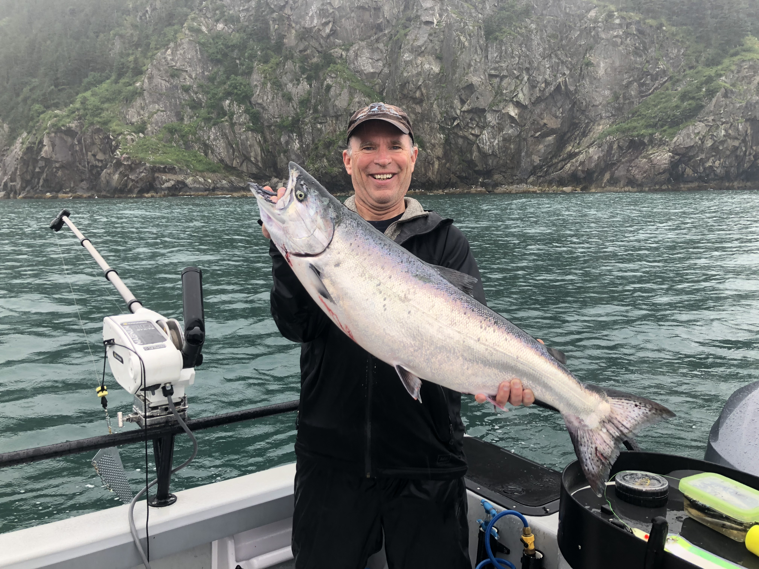
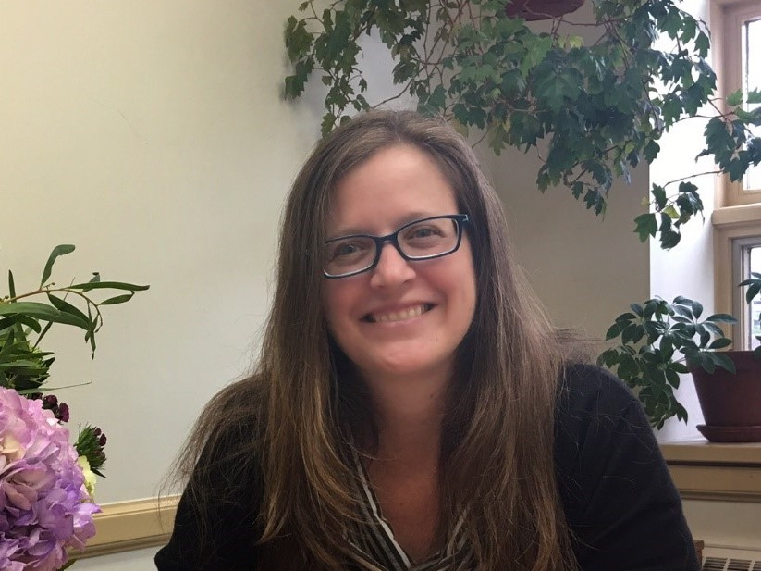
North Pacific
Fishery Management Council
David Witherell
Executive Director
Simon Kinneen, Chair
Alaska
Bill Tweit, Vice Chair
Washington
Diana Evans
Deputy Director

Slide 8

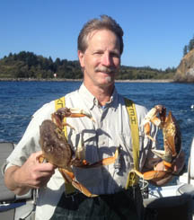
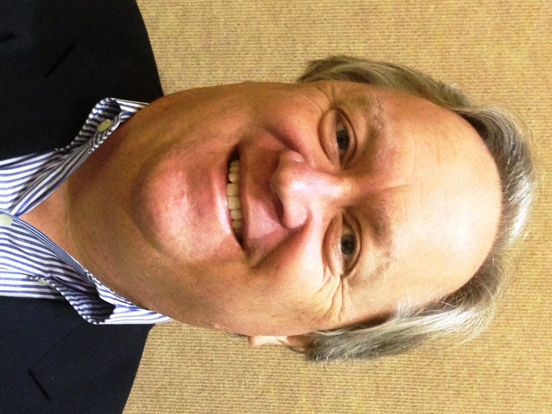
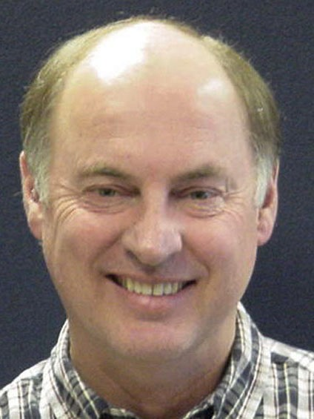
Pacific
Fishery Management Council
Chuck Tracy
Executive Director
Phil Anderson, Chair Washington
Marc Gorelnik, Vice Chair
California

Slide 9

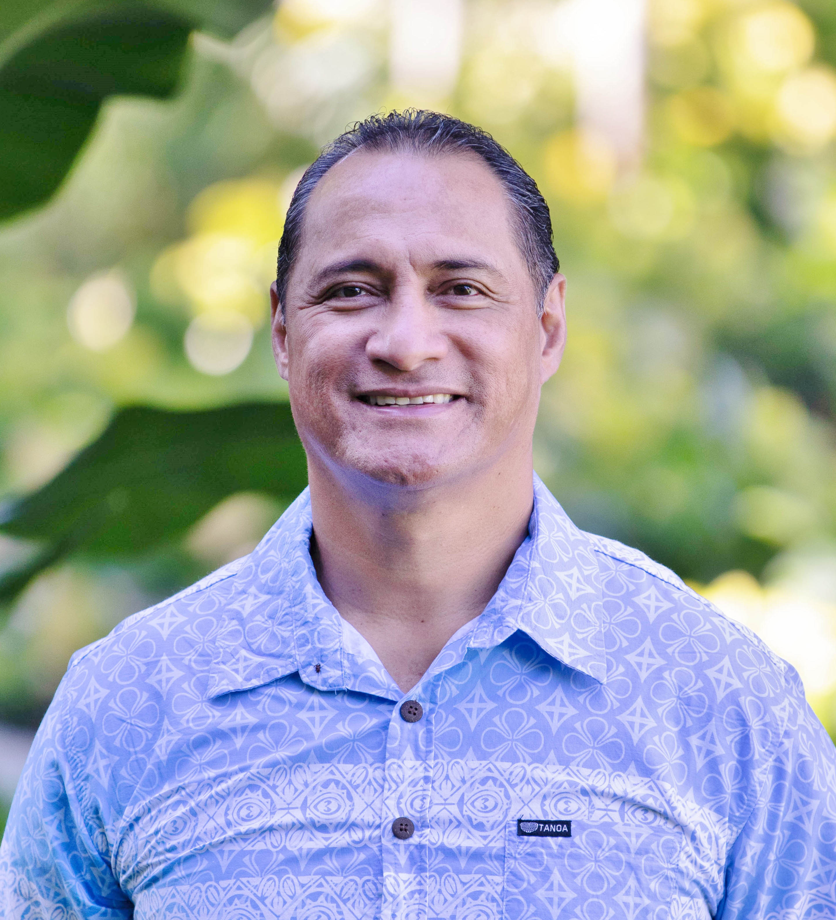
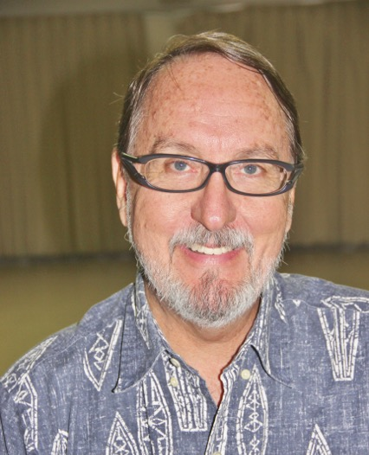
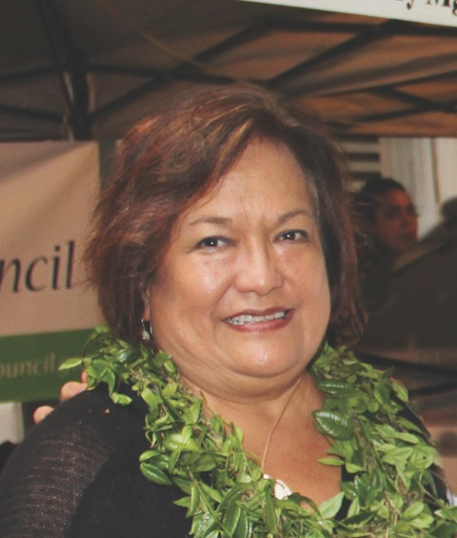
Western Pacific
Fishery Management Council
Archie Taotasi Soliai, Chair
American Samoa
John Gourley, Vice Chair
Northern Mariana Islands
Kitty Simonds
Executive Director

Slide 10
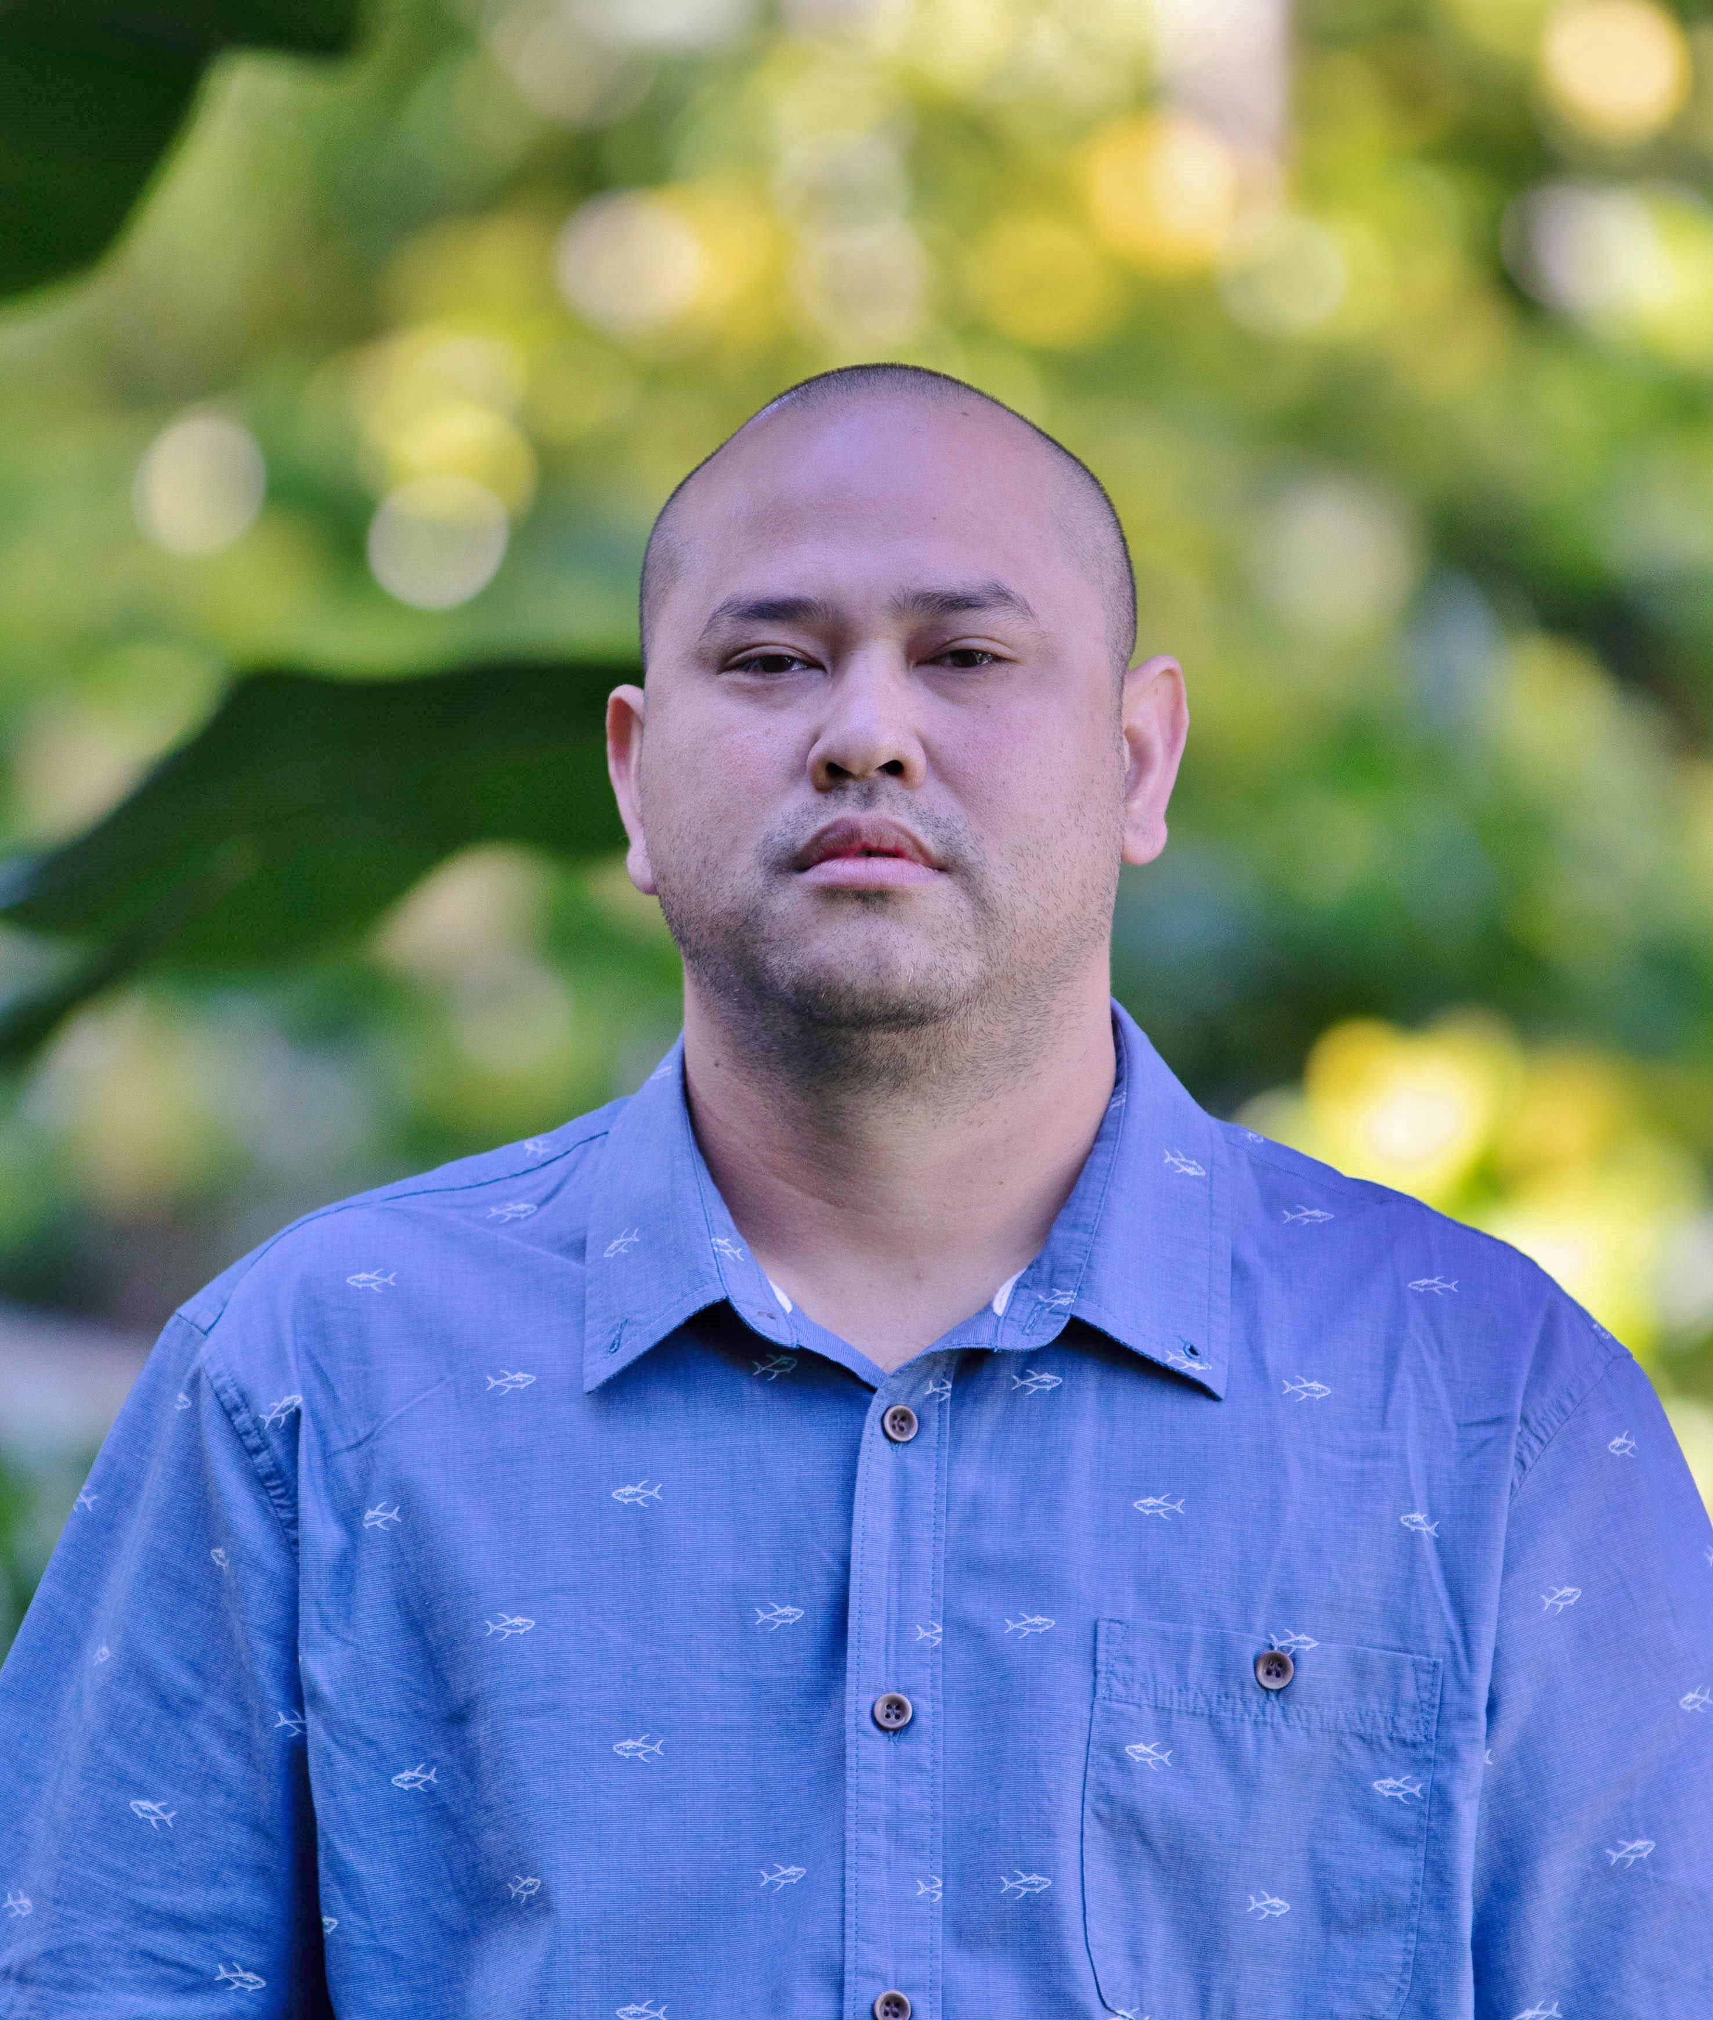
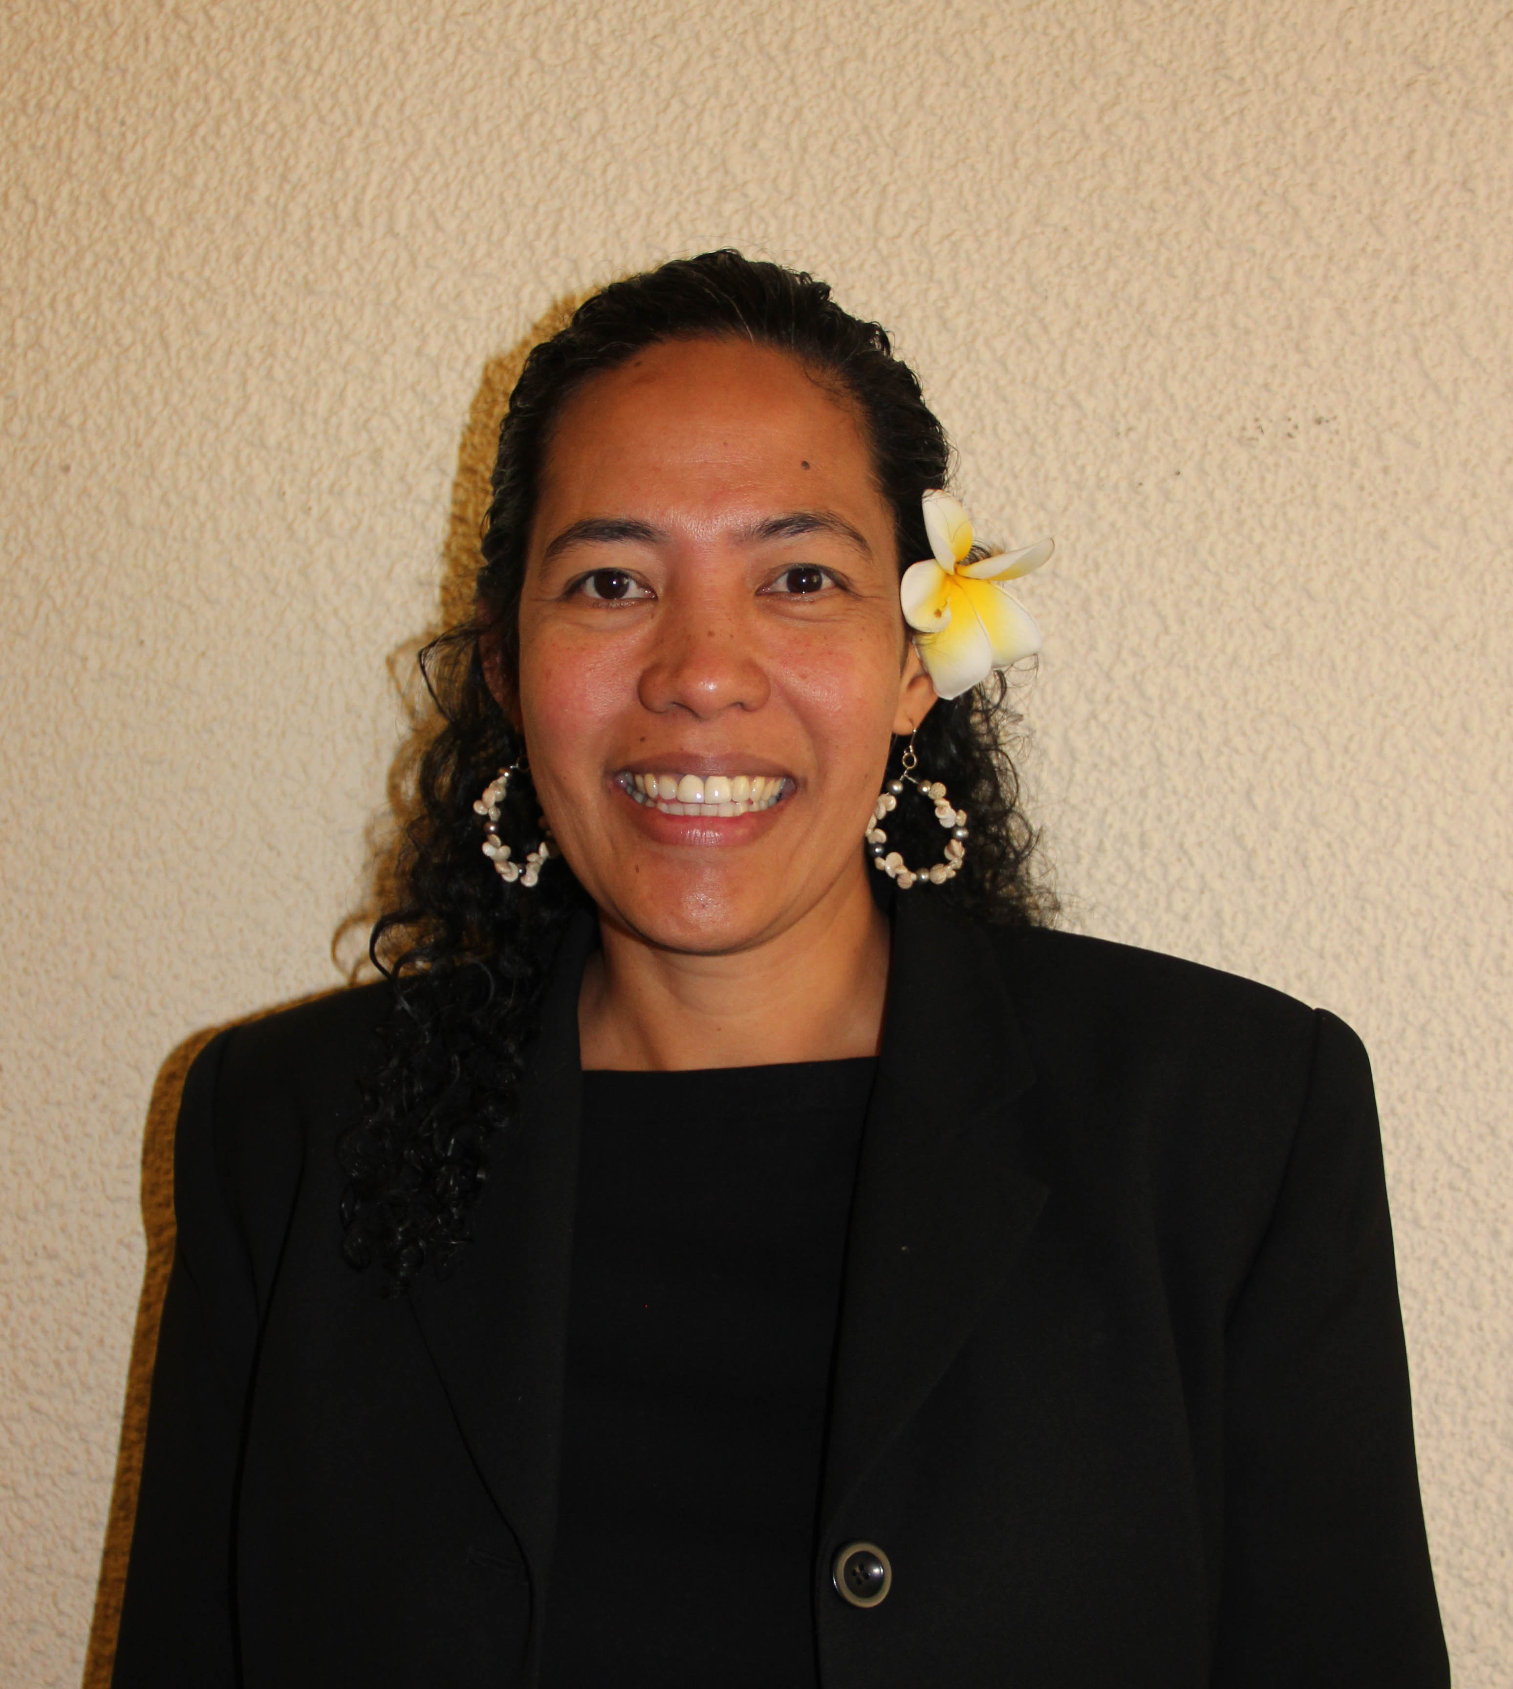
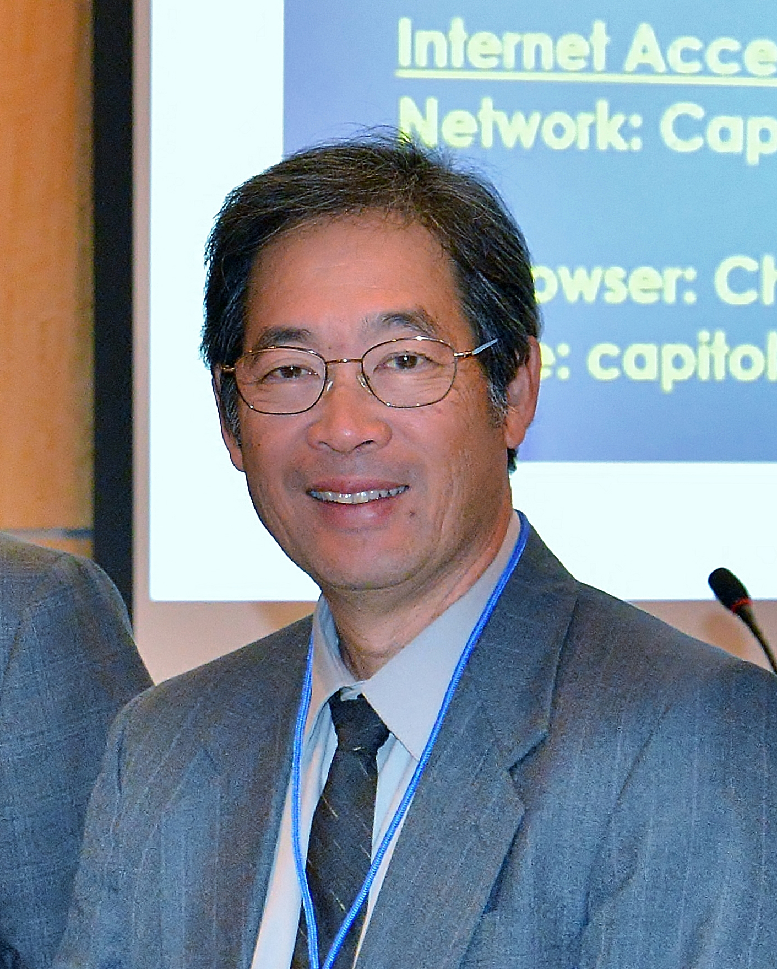
Western Pacific
Fishery Management Council
Michael Duenas, Vice Chair
Guam
Christinna Lutu-Sanchez, Vice Chair
America Samoa
Dean Sensui, Vice Chair
Hawaii

Slide 11
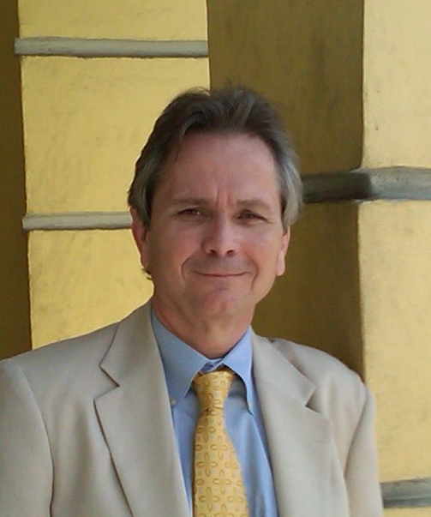
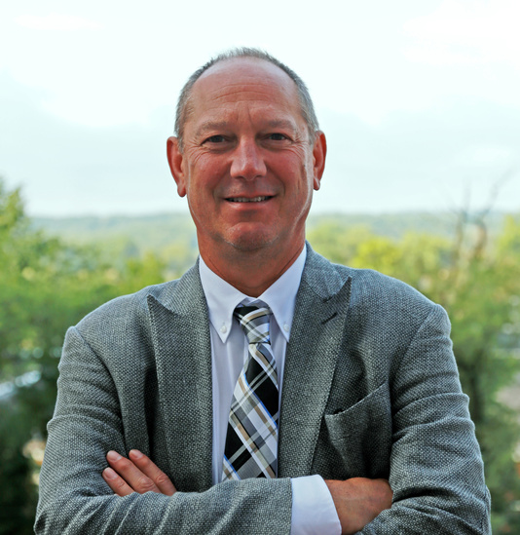
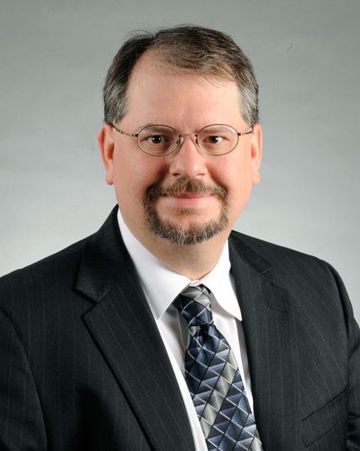
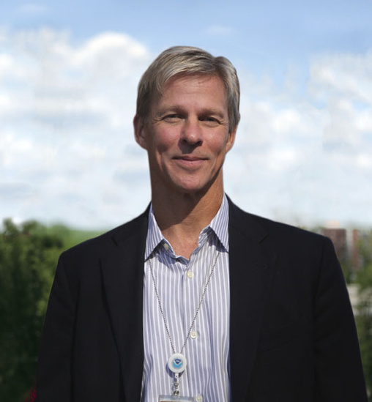
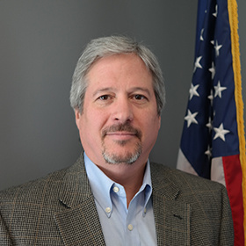

NMFS Leadership
Chris Oliver
Assistant Administrator for Fisheries
Sam Rauch III
Deputy Assistant Administrator for Regulatory Programs
Dr. Francisco “Cisco” Werner
Director of Scientific Programs and Chief Science Advisor
Dr. Paul Doremus
Deputy Assistant Administrator for Operations
Alan Risenhoover
Director Office of Sustainable Fisheries
Adam Issenberg
NOAA GC

Slide 12
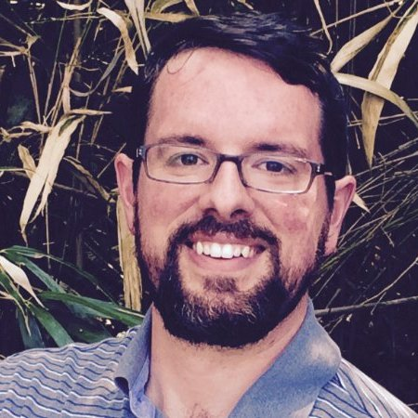
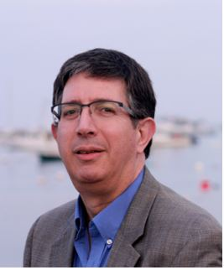
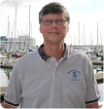
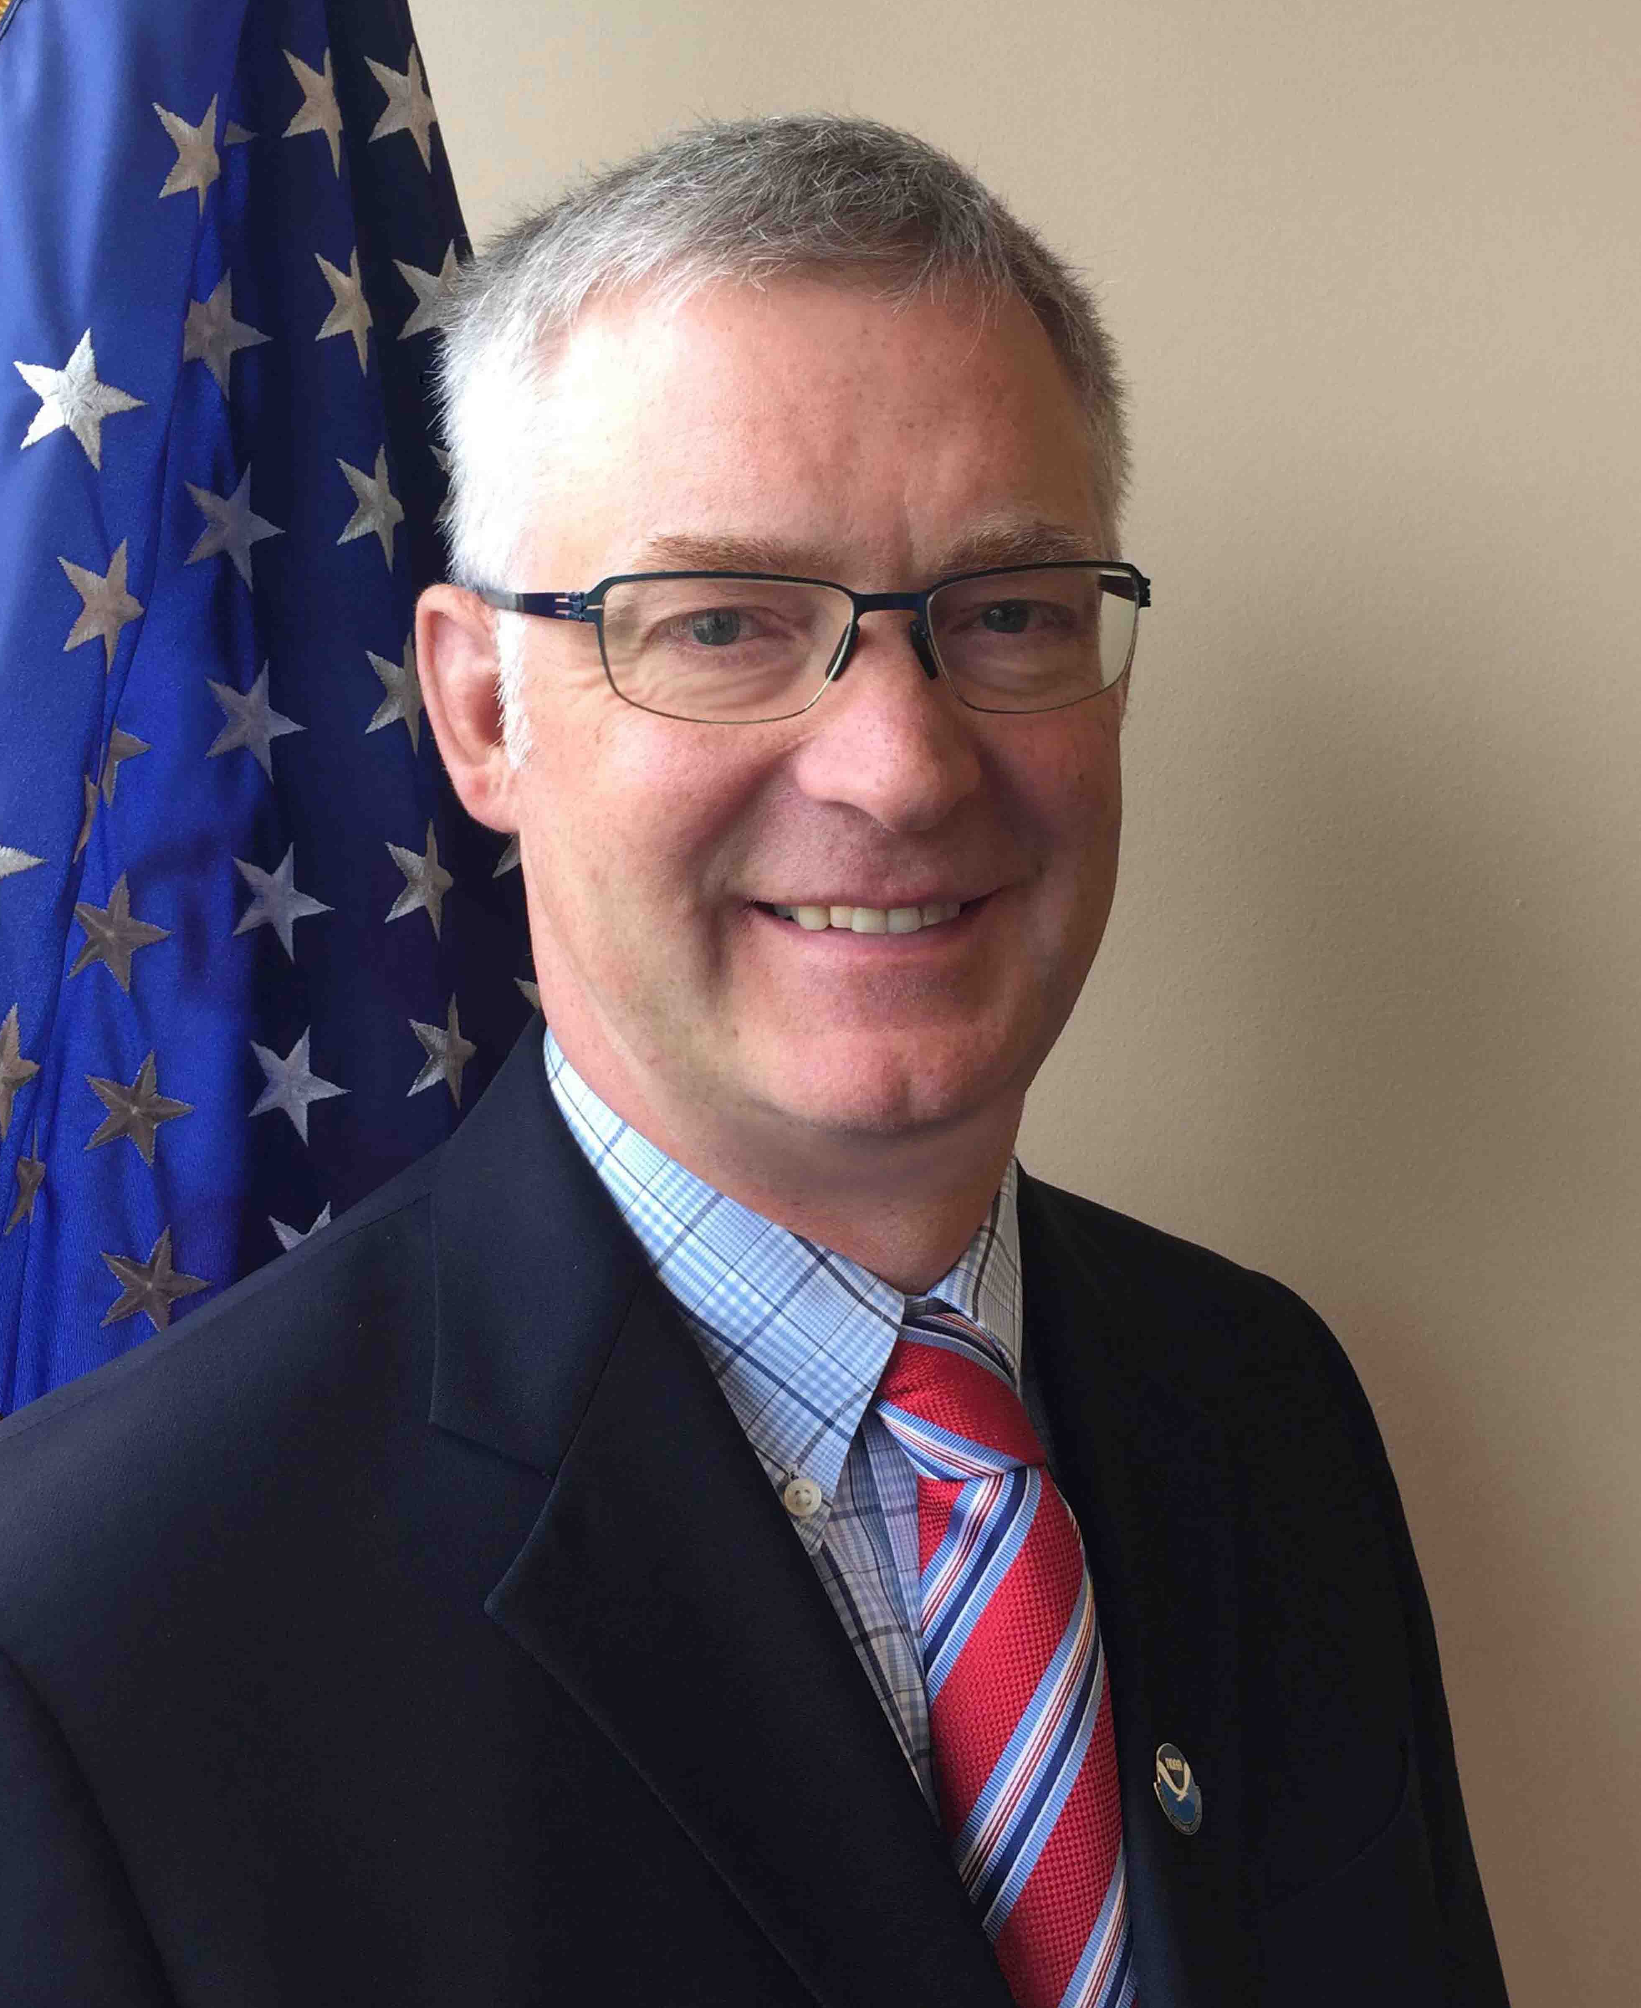
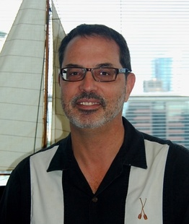
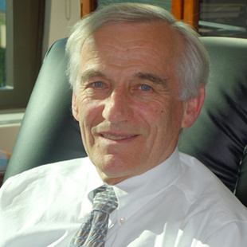
Brian Fredieu
Fishery Management Council Liaison
Mike Pentony
Greater Atlantic Region
Dr. Roy Crabtree
Southeast Region
Barry Thom
West Coast Region
Dr. James Balsiger
Alaska Region
Michael Tosatto
Pacific Islands Region

Slide 13
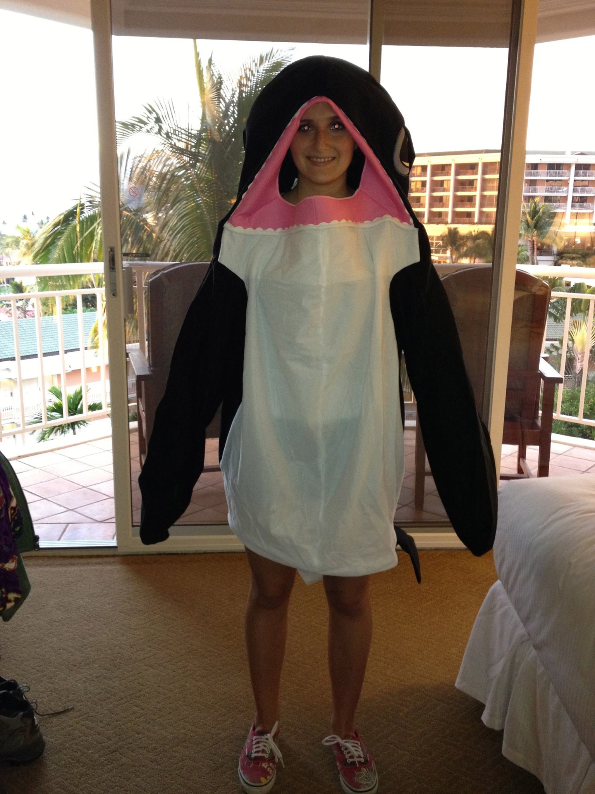
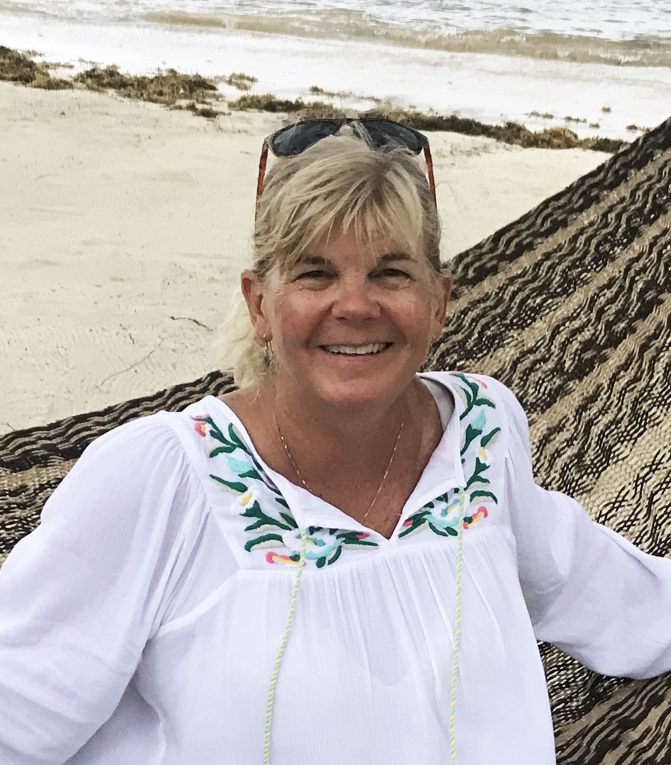
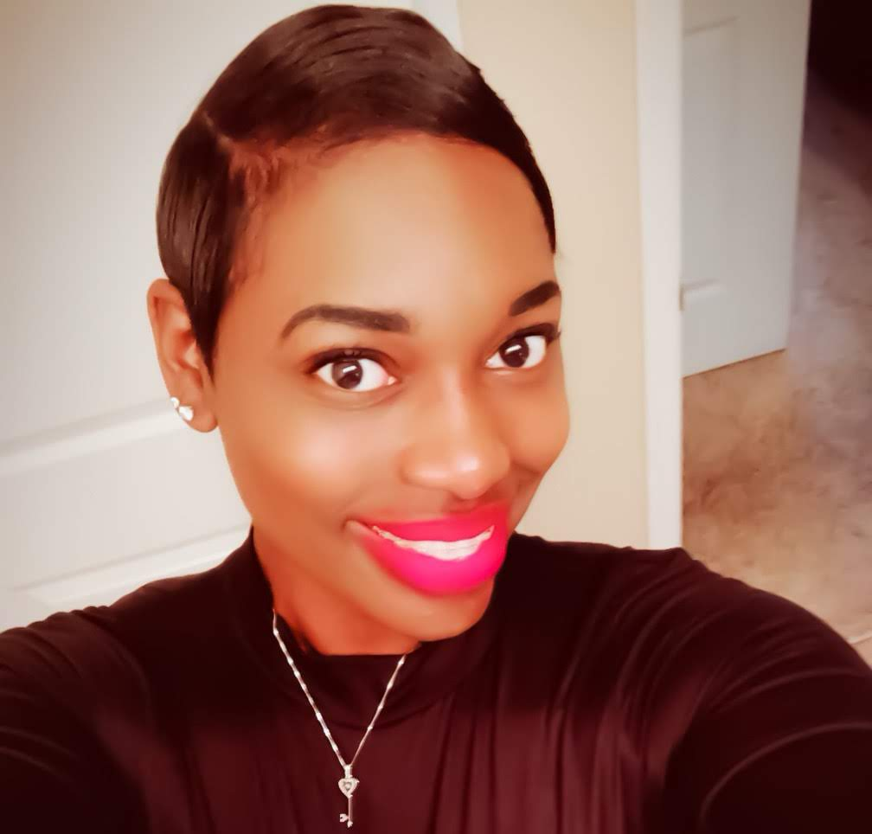
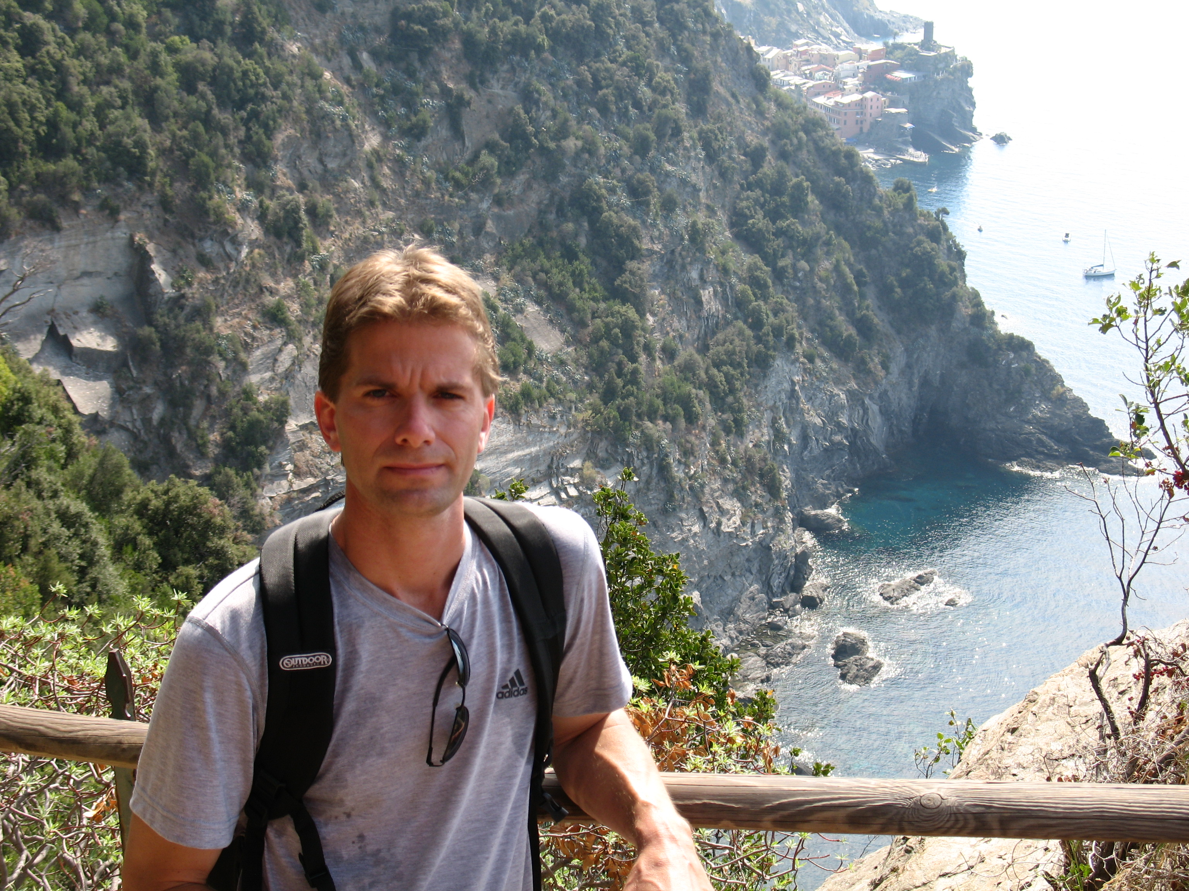
SAFMC Administrative/Outreach
Council Staff
Kim Iverson
Public Information Officer
Cameron Rhodes
Outreach Specialist
Kelly Klasnick
Administrative
Officer
Cierra Graham
Meetings & Grants
Coordinator

