Slide 1
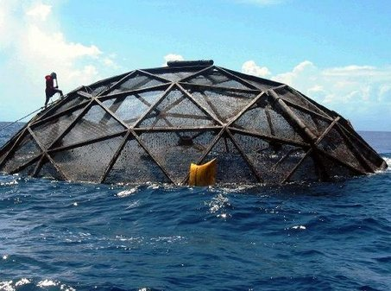
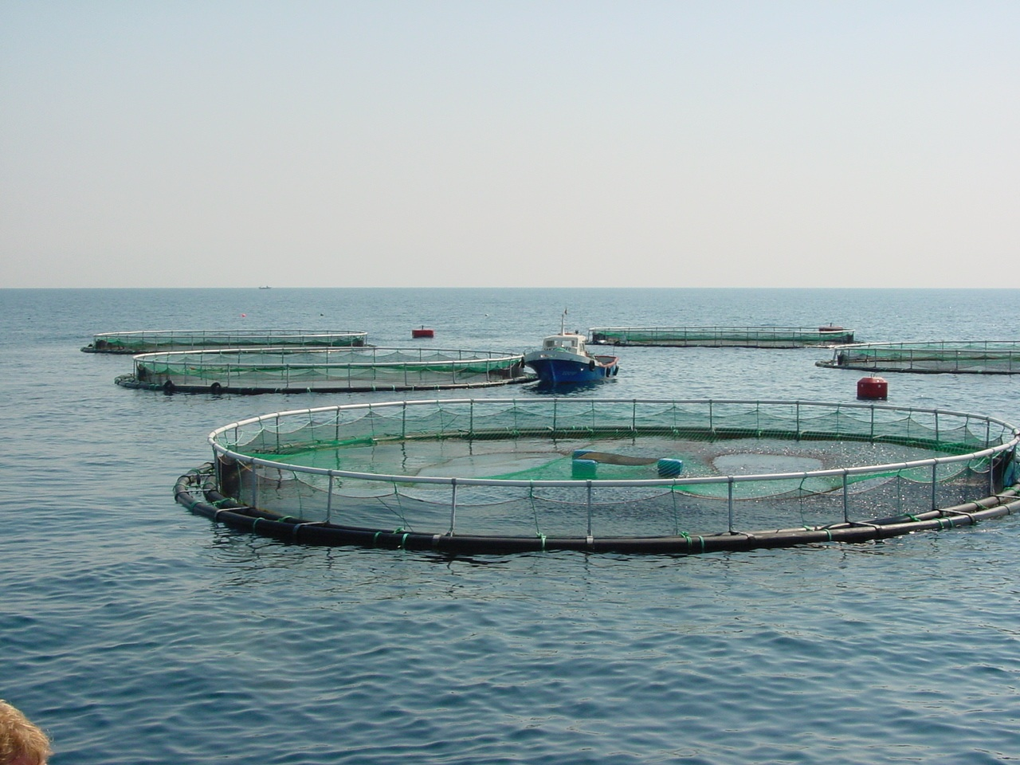
Brief Overview of the
Gulf Aquaculture FMP and Final Rule:
Lessons Learned

Slide 2
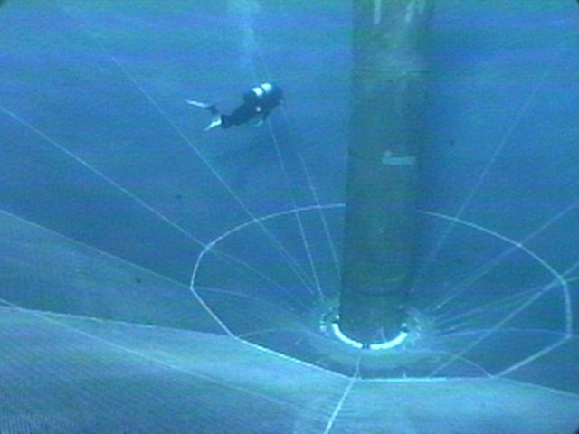
Presentation Outline
  Why: Rationale for Developing an FMP
  What: Brief Overview of FMP
  When: Timeline of FMP Through Final Rule
  Process Challenges:
      Public Input
      Implementation
      Litigation
  Council Next Steps
  Current EFP
  Lessons Noted

Slide 3
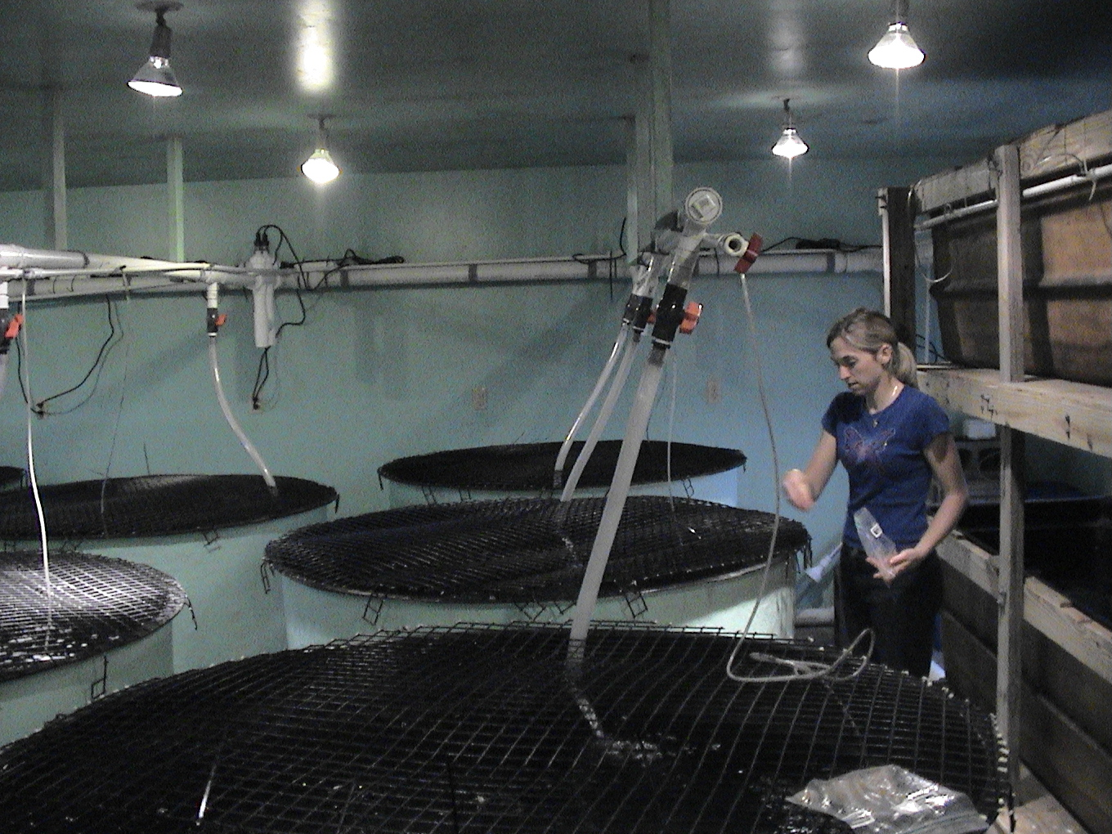
Why Pursue an FMP?
  Council was given guidance that harvesting fish (even cultured fish) falls under the Magnuson-Stevens Act.
  Simultaneously, NOAA was not progressing with a National Aquaculture Program.

Slide 4

What did the FMP Contain?
  Developed 10 Management Actions
  Permitting process and duration
  Application requirements and restrictions
  Guidelines for approval of system and siting
  Biological reference points and SDC
  Allowable species
  Restricted access zone
  Recordkeeping and reporting
  Framework procedure
Notes:
MSY and OY set at average landings of all marine species in the Gulf, except menhaden and shrimp, during 2000-2006. Capped OY to 20% of MSY

Slide 5
Timeline for FMP
  March 2003 – Scoping document
    2004 – Scoping meetings
  June 2007 – Approved Public Hearing Draft
    2007-2008 Public hearings
  January 2009 – Final Action
    Transmitted February 24, 2009
    FMP entered into effect September 3, 2009
  August 2014 – Proposed Rule
    November 2014 – Secondary comment period
  January 2016 – Final Rule

Slide 6
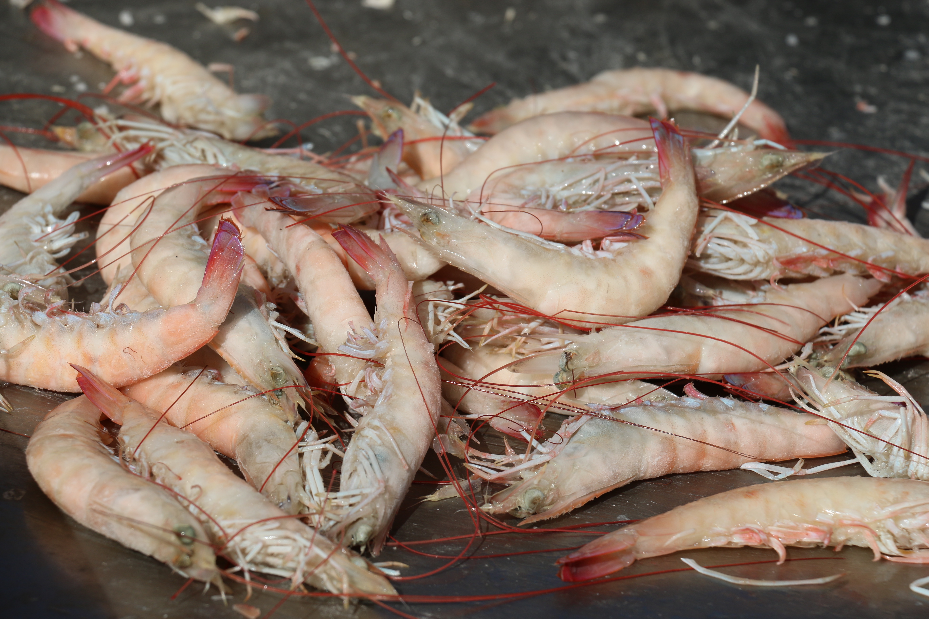
Process Challenges
  Polarized Public Comment
    Form letters in abundance
    Heated public testimony
  Transformed the Document
    Case-by-case evaluation by Regional Administrator
    Siting requirements
    Prohibiting species for culture
Notes:
Transformed the document
Led to less prescriptive requirements on gear types (evaluated by RA on a case by case basis)
More information on siting requirements
Prohibited species for culture
Only native, wild caught broodstock
No shrimp or coral (not cost effective or desirable)

Slide 7
Refined Gulf Aquaculture Permit (GAP) Process *not all inclusive
  Permit must be received 180 days prior to permit effective date
  RA decides if it is appropriate:
    No - Applicant has 60 days to correct deficiencies.
    Yes - Publish notification which opens a 45 day comment period.
    RA may consult with Council
  NMFS - SERO reviews comments and RA notifies applicant of decision and publishes FRN
  RA contacts EPA and US Army Corps to ensure applicant has received other federal permits
  SERO RA issues permit (can delay up to 2 years)
  GAP Permittees must abide by all requirements, if not violation may result in revocation or suspension

Slide 8
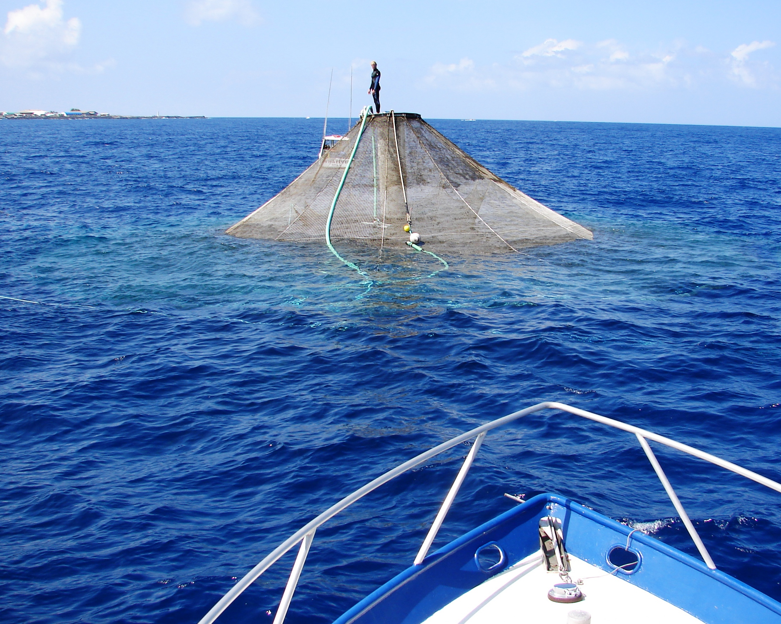
After FMP was Transmitted
Gulf FMP entered into effect by operation of law on September 3, 2009
NOAA announced development of new National Policy which would provide context for the Gulf FMP
Notes:
Counter to previous guidance provided which stated that MSA does regulate fish harvest
(EPA letter concurred that Councils can manage)

Slide 9
Prior to FMP Approval
Letter to Council explained that the only viable basis to disapprove the FMP was a determination that NOAA lacks the authority to regulate aquaculture under the Magnuson-Stevens Act
But that would indicate there is no overarching authority to address environmental and fishery concerns related to aquaculture operations in the EEZ
NOAA developed a Marine Aquaculture Policy and then reviewed the Gulf FMP again
Notes:
Counter to previous guidance provided which stated that MSA does regulate fish harvest
(EPA letter concurred that Councils can manage)

Slide 10
Process Challenges – Litigation
Prior to Publishing Proposed Rule
Complaints challenged the FMP on Premises:
    NOAA Secretary took no action (i.e., approving or disapproving FMP)
    FMP violated provisions of the Magnuson-Stevens Act and procedural requirements of NEPA
Defendants motion to dismiss was granted.

Slide 11
Process Challenges – Litigation
After Publishing Final Rule:
Complaints challenged the FMP on Premises:
    Violation of Magnuson-Stevens Act and lacks statutory authority
    Inconsistent with National Standard Guidelines
    Does not protect Essential Fish Habitat
    Violates Endangered Species Act and NEPA
    Does not ensure site-specific evaluation of impacts
    Failure to take a “hard look”
Case briefed and argued March 2018
Waiting on decision

Slide 12
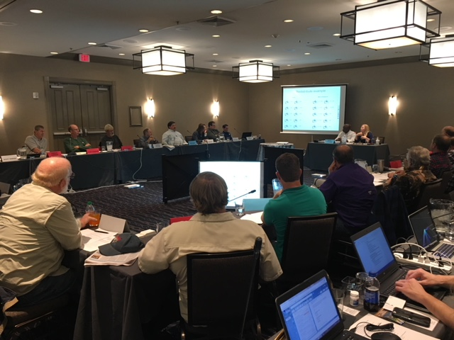
Council Next Steps
Council will appoint an Aquaculture AP
  Meet at least bi-annually to evaluate program
  Composed of Council staff, NMFS staff, SSC members, and other state, university or private scientists
  Develop a report with rationale for any recommended changes

Slide 13

Exempted Fishing Permit
Council reviewed an EFP from Velella-Epilson at the January and April 2018 meetings
These concerns were expressed:
  Greater Cooperation & Coordination with State of Florida
  Siting Analysis
  Environmental Assessment
  Genetic Testing of Broodstock
  Mooring System & Engineering Design
  Emergency/Contingency Plan for Severe Storms
Notes:
At the April 2018 Meeting the Council recommended approval of the EFP to NMFS.

Slide 14
Lessons Learned
First Regional Aquaculture FMP
Process in Southeast contentious – unable to utilize FMP to date (2003-2018)
Many safe guards and requirements in FMP
Combined with unknown business outcomes in Gulf of Mexico
Balance between species cultured, location, siting, competition with commercial fishing industry, and environmental organizations criterion

Slide 15
Questions?
Read the FMP here:
http://gulfcouncil.org/wp-content/uploads/Aquaculture-FMP-PEIS-Final-02-24-09.pdf
Read the NOAA-SERO Permit Application here:
http://sero.nmfs.noaa.gov/sustainable_fisheries/gulf_fisheries/aquaculture/

